Slide 1
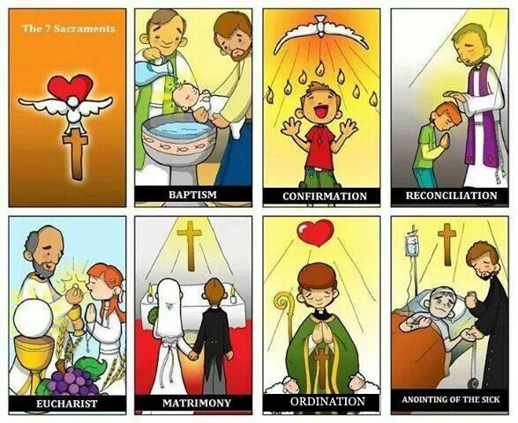
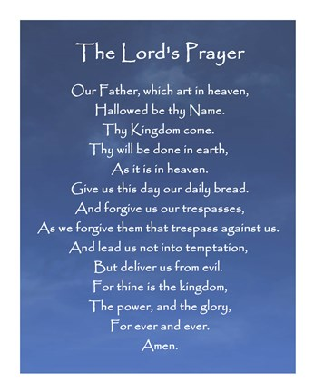
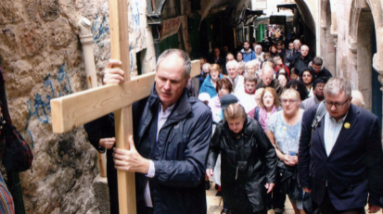
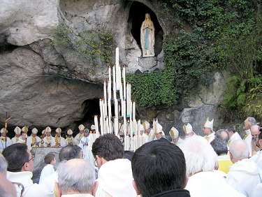
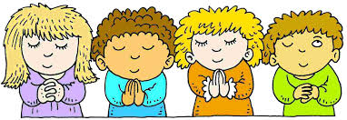
1. Worship
2. The role of the sacraments in Christian life
There are 7 sacraments in the Catholic Church.
The sacraments are essential in the life of Catholic Christians because:
- Through sacraments they receive grace and blessings from God
- Sacraments mark the journey of faith that Christians go through in life
- Sacraments make Christians stronger in their faith
- Sacraments bring Christians closer to God
- A sacrament is an outward and visible sign of an inward, spiritual grace
Most Protestant Christians have only 2 sacraments – baptism and Holy Communion. Some Protestant Christians do not have any sacraments at all (Quakers, Salvation Army)
Baptism | Catholics | Catholics are usually baptised as babies and their parents make promises on their behalf during the ceremony, in which: - Readings are said from the Bible about new life in Jesus - The priest talks about the responsibility of raising a child as a Catholic - Prayers are said for the needs of the family, the parish and the world -The parents and Godparents mark the child with the sign of the cross - The priest removes all sin by anointing the baby with oil - Water is poured over the child’s head as the priest recites ‘I baptise you in the name of the Father, the son and the Holy Spirit. Amen’ - The child is dressed in white garments - A candle is lit Its important for Catholics because: - Baptism is seen as necessary for a person to receive salvation - This person then becomes a member of the Church - Shows publicly that the child is now a Christian and intends to live a life as one - It copies the example of Jesus being baptised - It gives the parents strength and help in bringing up their child as a Christian
 | Baptists | Baptists practise ‘believers’ baptism. They usually have a dedication for their babies, but they believe that people need to be old enough to make vows for themselves when they have made their own decision to become a member of the Christian church. Baptists have a baptismal pool which is half filled with water or this can be done in the sea or a river. The main features of this ceremony are: - The person is asked if they believe that Jesus is Lord and that he died for their sins - They say a few words about how they came to believe in Christ - The minister lowers them completely into the water, saying ‘I baptise you in the name of the Father, the son and the Holy Spirit. Amen’ They are congratulated by the congregation and welcomed into the Church Its important because: - It signifies the end of their old like outside the church and born again to the new life in Christ - During baptism, Gods presence and blessing come upon them - Make a personal commitment of faith in Jesus - Receive God’s spirit for service in the Church and the world
The Eucharist/Holy Communion | Catholics | The Eucharist is part of the service of Mass. Catholics are expected to attend Mass every Sunday and on holy days. The wine is alcohol and drunk from a chalice; the bread is a thin wafer of unleavened bread known as the host. The main features of this sacrament are: - Confession of sins and receive absolution - Readings from the Bible and a sermon to learn about the faith - The Last Supper is re-enacted and the bread and wine are changed by a process called transubstantiation into the blood and body of Christ. - Holy Communion – receive the bread and wine - Priest blesses the people and sends them out into the world This is important because: - Catholics believe the bread and wine are turned into the blood and body of Christ and so Jesus is really present with them - It is a sacrament – a weekly gift of grace that gives them the strength for the week ahead - Celebration of the resurrection of Jesus – reminds them of eternal life - Jesus commanded ‘do this in memory of me’ so by taking the Eucharist they are following Jesus’ commands
 | Methodist | The Eucharist is known as Holy Communion and celebrated once a month. It is not compulsory. The wine is non-alcoholic and is drunk from individual glasses; the bread is normal bread. The main features of the sacrament are: - General confessions of sins - Sharing and peace and reciting the Nicene Creed - Thanksgiving and remembrance of the Last Supper - Sharing of bread and wine - Minster blesses the people and sends them out into the world. This is important because: - Holy Communion is a remembrance of the Last Supper and Gods mercy. The bread and wine do not change, they are symbols of the presence of Jesus. - Holy Communion gives spiritual nourishment, filling Methodists with God’s grace - Holy Communion brings unity to Methodists as they share the one body of Christ and share the peace - Reminder of the Last Supper and the crucifixion and resurrection of Christ
Liturgical worship Public worship in a church that uses set prayers and rituals. The worshippers can follow the service and join in certain parts. The words have been used for many years which means worshippers can develop their understanding. The Bible readings are based on the Christian calendar, this means that the congregation follow the main events of the Church’s year. This takes place as set times, especially on Sunday. | Non-liturgical worship Public worship in a church without set prayers and rituals. The leader of the worship is free to choose the hymns, prayers and Bible readings. These happen at set times, especially on Sundays. Music is often a major part with hymns or gospel songs. Prayers are unprepared but are based on thanksgiving and forgiveness. There will often be more congregational involvement with worshippers leading prayer of expressing approval of the sermon with ‘hallelujah’.
Informal prayer Many Christian families worship God at home by saying grace before meals, having family prayers, reading the Bible together and celebrating festivals. Many churches also have worship in much more informal ways, especially for families and young people. ‘Messy church’ provides worship for families, which is based on fun, creativity and celebration. | Private worship Most Christians will worship God at certain times on their own as they pray to God in private or read the Bible alone. Private worship is when Christians have the opportunity to talk to God and think about their faith.
3. The nature and purpose of prayer
Prayer – a way to contact God, usually through words.
Most prayer is vocal prayer, when words are used to express the prayer. However, prayer can also include meditation and contemplation.
Prayers can have several purposes:
4. Pilgrimage
Pilgrimage is a journey to a location of importance in religion.
Christians go on pilgrimage because:
- Some Christians feel that life is a search for God and this helps them in that search
- Many feel they become closer to God
- Pilgrimage takes time, planning and efforts and can make one consider their priorities in life
- Adds discipline to a Christians spiritual life
- Jesus went on pilgrimage to Jerusalem every year ‘ ‘Every year Jesus’ parents went to Jerusalem for the Festival of the Passover. When he was twelve years old, they went up to the festival, according to the custom’ (Luke 2:41-42)
- Pilgrims go to places like Lourdes in the hope of being cured from an illness, and many claim it gives them inner strength to cope
- Places of pilgrimage have special connections with great figures in Christian faith
Jerusalem
A major site in Israel where the crucial events in the last week of Jesus’ life took place. Pilgrims visit the following places:
- The Cenacle- thought to be the room where the Last Supper took place
- The Church of All nations – location where Jesus was arrested
- The Via Dolorosa – route Jesus took with the cross
- The Church of the Holy Sepulchre – the place where Jesus was crucified
- The Garden Tomb – Protestants often visit as thought to be the actual site of the crufixion.
Different types of worship are used because:
- People need to be able to worship in the home as this is the heart of people’s lives and worshipping as a family brings the family together
- People need to be able to worship God in private so they can communicate in front of others
- Informal worship helps people to see God in the ordinary and to realise that worship can happen anywhere in any way
- Worshipping with others in church gives a sense of belonging to a whole community of believers and gives an opportunity to feel the strength of the faith and make friends with others in the faith
A | Adoration | Praising or adoring God | Prayer can help a person to get things into perspective and focus on God
C | Confession | Confessing sins to God, asking forgiveness | Stop a person from bottling up guilt, help them to come to terms with what they have done and move on
T | Thanksgiving | . Thanking God for his goodness or for a specific thing | help a person not to be selfish and not to take things for granted
S | Supplication | Asking for God’s help either for oneself or others | Help a person feel they are doing something for those who suffer but can also inspire them to do something practically to help
Benefits of liturgical worship | Benefits of non-liturgical worship
- Worshipping with set prayers helps them to worship God in a familiar way so that worship becomes a part of life - Using ancient prayers and worship makes them aware of their Christian heritage - Using the same prayers as the rest of the Church gives them a sense of solidarity and belonging - Following the liturgical year helps them to understand their faith and learn more about God - Liturgical worship makes the worship important rather than the person leading prayer | - A more free form of worship helps people to participate in worship - It helps to reflect peoples moods from joy to sadness so that the worship comes from people’s own feelings - It allows worship to include forms people identify with such as rock and Gospel music - It helps to connect worship to the world of today
Martin Luther (Protestant) said: ‘All pilgrimages should be stopped. There is no good in them: no commandment enjoins them, no obedience attaches to them. Rather do these pilgrimages give countless occasions to commit sin and to despise God’s commandments’
Opposition to pilgrimage
Some Protestants oppose pilgrimage as they thought that they broke the commandment not worship idols.
Most Protestants tend to feel that ‘holy places’ are not needed as believers can encounter God everywhere.
They also oppose the worship of saints as they believe only God should be worshipped
Set prayer | Informal prayers
Liturgical worship is full of prayers expressing all four types. Many Christians come to know these prayers off by heart and use them as their own private prayers which will be at set times e.g. when waking up or before bed. | Most Christians also use informal prayers as part of their devotion. They will express their innermost thoughts to God, using their own words and language. This allows them to build a personal relationship with God. Christians may use informal prayers at set times or when they become aware of someone’s suffering
This prayer expresses:
- Adoration – ‘hallowed be thy name’
- Confession – ‘Forgive us our debts’
- Supplication – ‘deliver us from the evil one’

Slide 2
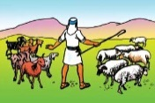
Easter
Christians prepare for Easter during Holy Week:
5. Religious celebrations
Christian festivals follow the liturgical year which begins with Advent, Christmas, Epiphany, Lent, Easter and Pentecost to Trinity.
Christmas - Most Christians celebrate the birth of Jesus on 25th December.
Advent
- Christians prepare for the coming of Jesus.
- Advent begins on the fourth Sunday before Christmas. During these four weeks, Christians remember the prophesies about Jesus’ coming, read Bible passages about the second coming of Jesus and the final Judgement.
- They usually light a candle on an advent wreath on each Sunday.
- Catholic are expected to free themselves from sin by receiving the sacrament of reconciliation. Christians hold carol services on Christmas Eve.
Christmas celebrations (Christmas lasts 12 days – ends on 5th January)
- Special services on Christmas Eve where a crib is often set up and blessed
- Christmas Day services to celebrate the birth of Jesus
- Gifts exchanged to remember the gifts given by the wise men and acknowledge God’s gift of his son to us
- Sunday after Christmas – remember the family life of Jesus
Christmas is important because:
- Celebration of the incarnation ; without this there would be no Christianity
- The arrival of Jesus meant that Christians could be a full relationship with God and receive salvation to go to heaven after death
- Christians feel united with all other Christians when they celebrate together, all Christians irrelevant of ethnicity, share a common faith
- Shows the importance of family. Christians remember the humility and strength of Mary and Joseph and try to be spiritually like them.
Easter Day
Exam Questions:
a) Outline 3 ways activities a Christian might do on pilgrimage (3)
a)Outline 3 examples of ways in which Christians have been persecuted around the world (3)
a) Outline 3 ways in which a Christian may pray (3)
b) Explain two reasons why some Christians prefer to use liturgical worship to worship God (4)
b) Explain why Jerusalem is important for Christians today (4)
b) Explain two ways in which a local church is important for the local area (4)
b) Explain two reasons why the Lord’s Prayer is important to Christians (4)
c) Explain two reasons why baptism is important for most Christians. In your answer you must include a source of wisdom and authority (5)
c) Explain two reasons why the Lord’s prayer is important for Christians. In your answer you must include a source of wisdom and authority (5)
c) Explain two reasons why Holy Week is significant for Christians. In your answer you must include a source of wisdom and authority (5)
d) Explain two reasons why worshippers in a Church community should evangelise in the local areas. In your answer you must include a source of wisdom and authority (5)
d) ‘It’s easy to be a Christian in today’s world’ Evaluate this statement considering arguments for and against. In your response you should:
Refer to Christian teachings
Refer to different Christian points of view
Reach a justified conclusion (15)
d) ‘All Christians should give money to charity’ Evaluate this statement considering arguments for and against. In your response you should:
Refer to Christian points of view
Refer to different Christian points of view
Reach a justified conclusion (15)
d) ‘Each area should have one Christian church, you don’t need separate churches for each denomination’ Evaluate this statement considering arguments for and against. In your response you should:
Refer to Christian teachings
Reach a justified conclusion (15)
d) ‘Christmas is more important than Easter’ Evaluate this statement considering arguments for and against. In your response you should:
Refer to Christian points of view
Reach a justified conclusion (15)
d) ‘All Christians should go on pilgrimage to Jerusalem’ Evaluate this statement considering arguments for and against. In your response you should:
Refer to Christian points of view
Refer to different Christian points of view
Reach a justified conclusion (15)
Easter Day is the festival of joy as Christians celebrate the resurrection. Some Christians celebrate with the Easter Vigil which has:
- A ceremony of light to remember the darkness of the tomb and the light of the resurrection
- Bible readings to remember the resurrection brought back the goodness of the world
- A renewal of baptismal vows to remember rebirth
- The Eucharist to remember that salvation comes through the sacraments
All Christians have a joyful service to celebrate the hope for eternal life which this brings to individuals. The tradition of Easter eggs comes from the fact that an egg represents new life.
Catholics have a second mass which is the only occasion where they are allowed to take communion twice in one day.
Easter Day is important because:
- It celebrates the resurrection of Christ which proves the identity of Christ as stated in the Nicene Creed
- It is the final part of Jesus’ work on earth and now people can be restored with God after death
- It proves that death is not the end
- Gives assurance that Jesus is not dead and can continue to help guide Christians
- Celebrates Jesus’ victory over death and evil
- Proves that the predictions that Jesus made about his death and resurrection were true and so Christians can assume his other teachings are true too.
Palm Sunday | Remembers the way Jesus was welcomed into Jerusalem by the crowds laying down pam leaves. Christians celebrate by processing with palm leaves near the church, Bible readings of the events of Palm Sunday and distributing palm crosses to the congregation
Maundy Thursday | Remembers the Last Supper of Jesus and his disciples. Christians celebrate with a special Eucharist where the priest washes the feet of the congregation as Jesus washed the disciples feet. They have readings from the last Supper. In Catholic and Church of England, the altar is stripped and all crosses are covered as Good Friday and Holy Saturday are days of mourning.
Good Friday | Remembers the death of Jesus. Many Christians have a walk of witness carrying a cross. They then have a 3 hour service to mark the time Jesus was on the cross. Catholic churches have prayers at the stations of the cross
Holy Saturday | A day of reflection and prayer. No services are held
Holy Week is important because:
- Christians have an opportunity to renew and deepen their faith in Jesus through remembering these events
- It reminds them how Jesus faced worship one day followed by rejection on another
- Palm Sunday reminds Christians that Jesus is the Messiah and worthy of their praise
- Maundy Thursday reminds them of the importance of the Eucharist. The foot washing reminds them of the need to serve others
- Reminds Christians of Jesus’ suffering and how they too can cope with suffering they may face
- Reminds them of the salvation brought by Jesus
Living a Christian life
6. The future of the Church
Missionary and evangelical work
A missionary is a person sent by a Church into an area to bring people into the Christian Church.
Evangelical work is proclaiming the message of Christianity with the aim of converting people to Christianity.
Jesus commanded:
‘ He said to them, ‘Go into all the world and preach the gospel to all creation. Whoever believes and is baptised will be saved, but whoever does not believe will be condemned.’ (Mark 16:15-16)
The disciples of Jesus began their work immediately, The Acts of the Apostles in the New Testament records conversions in Palestine, Ethiopia, Africa, Syria, Turkey and Greece. Tradition says that St Thomas converted Christians in Egypt, Iraq, Iran, North Africa and the European parts of the Roman Empire. When Europeans began to colonise America and Africa, missionaries went too and spread the Christian faith.
National missionary and evangelical work
- Alpha course – aims to introduce non-churchgoers to the Christian life through lectures and classes
- Hope – an organisation that provides resources and ideas for evangelism in the local communities
- Youth for Christ (YFC) – provides resources for churches and schools and runs residential trips to bring the Christian message to young people outside of church.
Global missionary and evangelical work
- Evangelical protestants have been trying to send missionaries to every ethnic group in the world. Latin American, African and Korean missionaries can now be found all over the world
- Society of the Propagation of the Faith – Roman Catholic missionary organisation which is funded by donations to the church. They work to support religious communities (monk and nuns) and the building of chapels, churches, orphanages and schools.
Different Christian views on the importance of missionary and evangelical work
7. Importance of the local church
The role and importance of the local church in the local community
- The church is where people go to show devotion to God
- Special services are held for festivals
- It offers the sacraments to people
- Provides marriage services
- Prayer groups, Bible study and sermons so that Christians can learn more about their faith
- Gives Christians in the area a sense of belonging
How the local church helps the local area
How the local church helps the local area which follows Jesus’ demands in the Parable of the Sheep and the Goats
- Supporting the local Christian schools
- Social facilities e.g. youth clubs, mother and baby classes to help people make friends
- Lunch clubs for elderly people
- Hosting discussion groups
- They may also be involved in outreach projects by:
- Christian counselling services that help families experiencing difficulties
- priests giving advice to couples experiencing marriage difficulties
- providing financial support
- providing legal advice
- supporting charitable causes
- providing help for the needy e.g. food banks, helping local homeless shelters
The local church and ecumenism
This is the co-operation of the different denominations within Christianity. Local churches come together in all sorts of ways such as services, social gatherings and discussion groups. They often plan efforts together to work for Christian charities or helping people in the local community.
8. The worldwide Church
The Church in the world
Christianity is the world’s largest religion with approx. 2.4 billion Christians around the world. The Church has a world presence:
- The Catholic Church, based in the independent state of the Vatican belongs to the United Nations
- Other Christians Churches are represented at world level by the World Council of Churches, whose headquarters are in Switzerland, next to the UN.
The Church and Reconciliation
One of the four aims of the World Council of Churches is:
‘engage in Christian service by serving human need, breaking down barriers between people, seeking justice and peace, and upholding the integrity of creation’
Christians believe in reconciliation because:
- Humanity has split from God through sin and Jesus died on the cross for salvation and reconciliation
- Jesus said if people do not forgive others, God will not forgive them
- St Paul said that Christians should try to live in peace with everyone. Peace comes from reconciliation
- Christianity is based on the principles of forgiveness and reconciliation
Problems faced by the persecuted Church
There are several countries in the world where it is not safe to be Christian:
- North Korea – Christians in North Korea must worship the nation’s leader and following another religion makes you the enemy. Thousands are being tortured and imprisoned.
- Somalia – Al-Shabaab, A Muslim group wish to rid Somalia of Christians and people suspected of being Christian would be killed instantly. Many meet in secret and cannot own Bibles.
- Syria – 700,000 Christians have fled Syria , in parts claimed by ISIS Christians have been abducted and killed
Christian teachings about charity
Parable of the Sheep and the Goats
Christianity teaches that God created humans to be stewards of the earth and that God wants Christians to love their neighbours. This means that riches must be used to help others, particularly the poor.
This is taught in Matthew 25:31-46
Jesus said that:
- He would separate the people like a shepherd separates the sheep from the goats
- The sheep would be those who fed Jesus when he was hungry, gave him drink when he was thirsty, took him in when he was a stranger, clothed him when he needed clothes, looked after him when he was sick and visited him in prison
- The people will say they never did this but Jesus will say that whatever they did for someone suffering like this, they did for him, so they can go to heaven
- Jesus identifies with those who suffer in the parable
- The goats will be told that they did not do any other these things for others because they do not love others and they will go to hell
Christians believe the parable means:
- Christians need to show love for everyone, especially those in need
- By showing love to others, you are showing love to God
- People will be judged to the way they treat others
- Love of others is what God wants, this means that no-one suffers
- Shows that there is a reward for showing love
- Shows that people who choose not to help those in need with be punished
Christian Aid
Christian Aid is the major Christian charity based in the UK. It aims to help where the need is greatest. The work they do includes:
- Christian aid speaks on the behalf of others to bring social justice.
- Promotes Fairtrade products
- Working to eradicate debt of less developed countries
- Arranges marches, working with businesses and talking to governments about what they can do to make the world a fairer place
- Development projects in Africa, Latin America, Middle East and Asia e.g. have used solar technologies to develop solar powered fridges, water heaters and water pumps to improve standards of living.
- Disaster fund – provides emergency aid such as water, food, antibiotics and shelters to disaster zones (natural disasters or refugees)and raise more money to help them further.
Christian aid work for world poverty because:
- New Testament teaches that riches should be used to help others
- All Churches teach that Christians have a duty to help the poor
- Parable of the sheep and the goats
- Golden Rule ‘Treat others as you would like to be treated’ – they believe that if Christians were suffering from poverty, they would want help and support from the rich.
Topics | I’ve got it! | Bits and bobs! | Oh dear! | Questions I still have
Christian Worship
The role of the sacraments in Christian life and their practice in two denominations
The nature and purpose of prayer
Pilgrimage
Christian religious celebrations
The future of the Christian Church
The role and importance of the local church in the local community
The role and importance of the church in the worldwide community
Missionary work is important because: - Jesus told Christians their duty was to preach the Gospel and bring the world to the Christian faith - Should share their faith with others out of love as this helps to share God’s love - Non-Christians can only have their sins forgiven by becoming a Christian - Question whether non-Christians can reach heaven - Concern about the decline in religion | Some Christians believe that missionary work is no longer important because: - Trying to convert others in a multi-faith society is a form of prejudice and discrimination - Many in less developed countries may resent missionary workers as view them as a new form of colonisation - Most important command from Jesus was to love God and your neighbour. - See problems that missionary work is causing in Muslim countries

