Slide 1
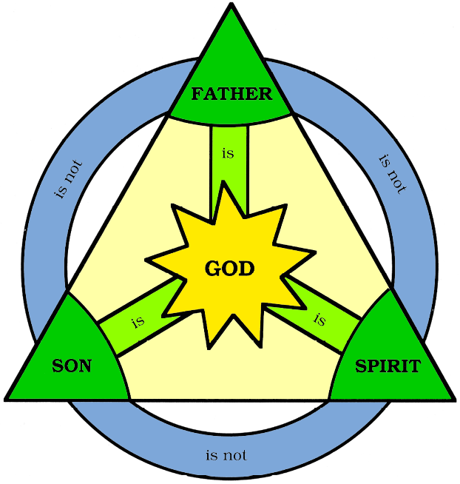
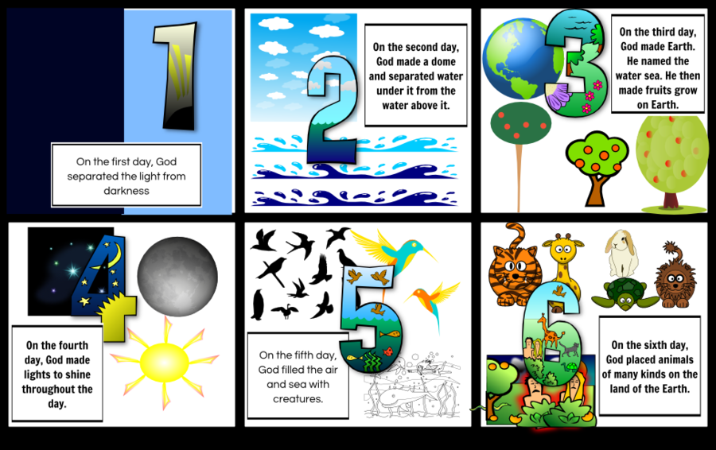
 | The prayer Jesus taught his disciples that begins ‘Our Father’
 | The Christian service of thanksgiving using bread and wine (also called Eucharist)
 | The idea that humans are free to make their own choices
 | Looking after something so it can be passed on to the next generation
 | The belief that God took human form in Jesus
 | The books of the Bible (Matthew, Mark, Luke and John), which are the only record of Jesus’ life
 | The day before Jesus was crucified (Good Friday)
 | Speaking disrespectfully about God or sacred things
 | The return of Christ to heaven
 | A short statement of belief attributed to the disciples of Jesus
 | An act that is against God’s will
 | The act of delivering from sin and saving from evil
 | God’s gift which gives strength to be good and holy
 | Reconciliation between God and humans
 | Bringing together people who were opposed to each other
 | An outward ceremony through which God’s grace is given
 | A place where Catholics believe souls go after they death to be purified
 | The belief that, after death, the body stays in the grave until the end of the world, when it is raise
 | A place of paradise in the presence of God
 | A place of horrors where Satan rules
 | The idea that the soul lives on after the death of the body
 | Someone who does not believe that God exists
 | Someone unsure as to whether or not God exists
 | Suffering caused by actions done by humans
 | Suffering which is caused by nature and has nothing to do with humans
 | The belief that God is all-powerful
 | The belief that God is all-good
 | The belief that God knows everything that has happened and everything that is going to happen
 | The prayer Jesus taught his disciples that begins ‘Our Father’
 | The Christian service of thanksgiving using bread and wine (also called Eucharist)
 | The idea that humans are free to make their own choices
 | Looking after something so it can be passed on to the next generation
1. The Trinity
Task: List two reasons why Christians believe that there is one God:
-
-
Task: Read the extract from the Nicene Creed. Highlight the sections in different colours that refer to the Father, the Son and the Holy Spirit.
‘We believe in one God, the Father, the Almighty…we believe in one Lord Jesus Christ, the only Son of God, eternally begotten of the Father, God from God…begotten not made, of one Being with the Father…We believe in the Holy Spirit, the Lord and giver of life, who proceeds from the Father and the Son. With the Father and the Son he is worshipped and glorified’
Task: List two ways in which the Trinity is shown in Christian worship
-
-
Task: What role does each person within the Trinity do?
Father
Son
Holy Spirit
Task: What group of Christians do not agree with the Trinity? Why?
____________________________________________________________________________________________________________________________________________________________
2. The creation of the universe and of humanity
Task: Summarise the three creation stories found in the Bible
3. The Incarnation
Task: What do Christians believe about the incarnation?
________________________________________________________________________________________________________________________________________________
Task: What does it say in the Bible about the incarnation?
Task: List three reasons why the incarnation is important?
-
-
-
‘Beyond all question, the mystery from which true godliness springs is great: He (Jesus) appeared in the flesh, was vindicated by the Spirit, was seen by angels, was preached among the nations, was believed on in the world, was taken up in glory’ (1 Timothy 3:16)
Genesis 1
Genesis 2-3
John 1-3
Matthew’s Gospel
Luke’s Gospel
John’s Gospel
Task: What are the different attitudes to the Biblical creation stories? Christian
Literalists believe ….
Conservatives believe…..
Liberals believe…..
Task: Outline three reasons why the creation stories are important to Christians
-
-
-

Slide 2
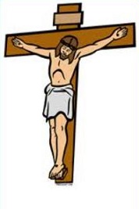
4. The last days of Jesus’ life
Task: Summarise what happened on each day before Jesus died
5. The nature of salvation
Task: Summarise the role of Jesus in salvation
____________________________________________________________________________________________________________________________________________________________________________________________________
Task: Outline three ways in which a Christian can receive salvation
-
-
-
Task: Summarise why salvation from sin is important to Christians
____________________________________________________________________________________________________________________________________________________________________________________________________
Task: Summarise the different Christian attitudes to salvation
7. The problem of evil and suffering
Task: Summarise the difference between the two types of suffering
Task: Outline three reasons why evil and suffering may cause people to question Gods existence
-
-
-
8. Solutions to the problem of evil and suffering
Task: Summarise two different points for each of the Christians responses to evil and suffering
The Last Supper/Maundy Thursday
The betrayal and arrest
The trial
The crucifixion
The resurrection
The ascension
Moral suffering is…. | An example is….
Natural suffering is… | An example is…
Roman Catholic
Evangelical Protestant
Liberal Protestant
Biblical responses | Book of Job
 | Psalms
Theoretical responses | Free Will response
 | Vale of soul making
Practical responses | Praying
 | Practical help
6. Christian eschatology
Task: Summarise the Christian beliefs about the following aspects of life after death
Task: Read the SOWA below and decide which event in the last days of Jesus’ life it comes from
Resurrection of the body
Immortality of the soul
Heaven and Hell
Purgatory
The final Judgement
‘Father forgive them, for they do not know what they are doing’ (Luke 23:34)
‘Then he took the cup, gave thanks and offered it to them, saying, ‘Drink from it, all of you. This is the new covenant in my blood which is poured out for you’ (Luke 22:20)
“All authority in heaven and on earth has been given to me. Go therefore and make disciples of all nations, baptizing them in the name of the Father and of the Son and of the Holy Spirit, teaching them to observe all that I have commanded you’ (Matthew 28: 16-20)
1:1 Christian beliefs | Sections
 | The Trinity
 | The creation of the universe and of humanity
 | The incarnation
 | The last days of Jesus’ life
 | Nature of salvation
 | Christian eschatology
 | The problem of evil and suffering
 | Solution to evil and suffering
Task: Now that you have had a chance to test your memory, use the PLC to indicate your focus areas for further revision before your exam.
Task: List three differences in the recording of Jesus’ life in the Gospels
-
-
-
Task: List three reasons why these events are important for understanding the purpose of Jesus
-
-
-
Task: Outline three teachings from the Bible that tell Christians about life after death
-
-
-
Task: Outline three reasons why teachings about life after death are important to Christians today
-
-
-

