Slide 1
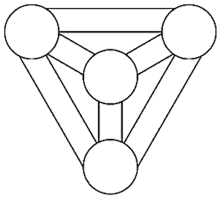
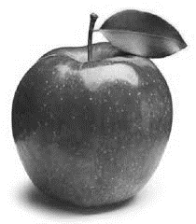
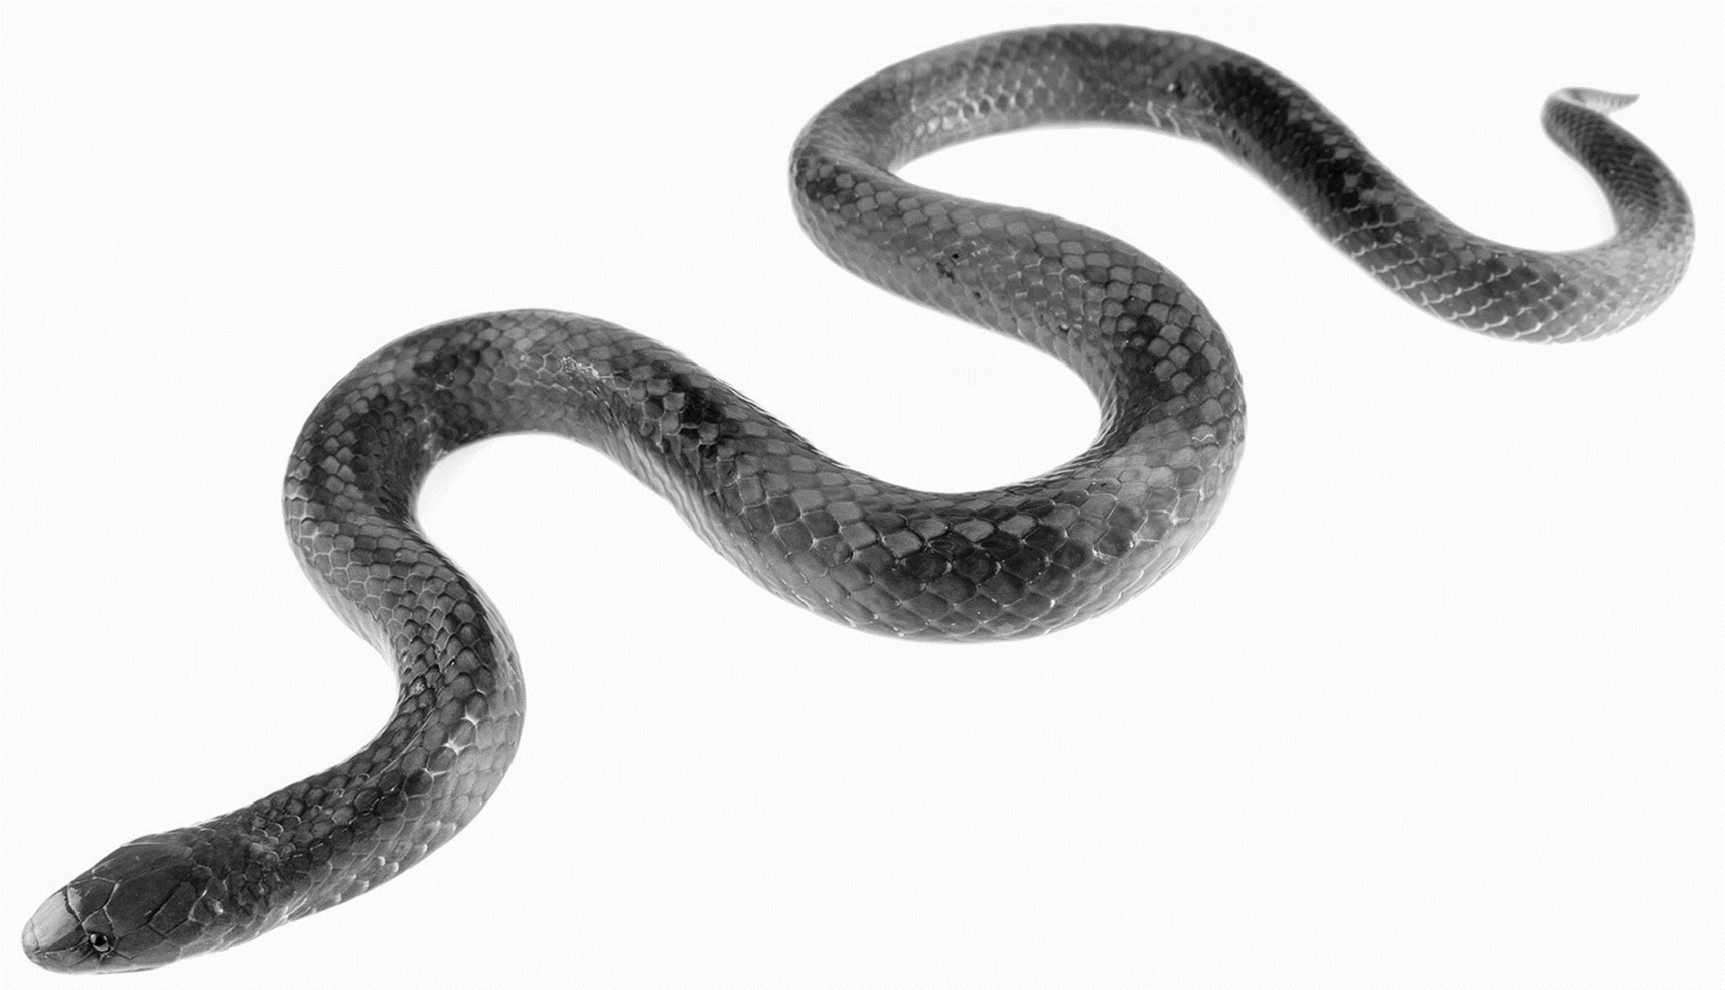
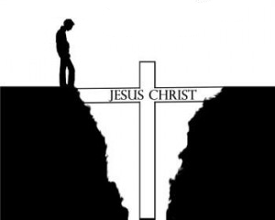
CHRISTIAN BELIEFS
CREATION
ESCHATOLOGY: AFTERLIFE
GOD
Sin
Heaven
Purgatory
Hell
Gospel of John
Genesis 1
1
2
3
4
5
6
7
Parable of the Sheep and Goats
Parable of Lazarus and the Rich Man
Salvation
EVIL
Resurrection
“For the trumpet will sound, the dead will be raised imperishable.”
1 Corinthians
The Story of Job
INCARNATION
The Last Supper
Genesis 2
THE FALL
Genesis 3
JESUS
CRUCIFIXION
“God created human beings in his own image. In the image of God he created them.” Genesis 1:27
“The Word was made flesh.” John 1:14
RESURRECTION
The Apostles Creed
Key Term | Definition | Example/Explanation
Omnipotent
Omnibenevolent
Trinity
Incarnation
Atonement
Resurrection
Sacrament
Evangelism
INTERPRETATIONS
Fundamental
Traditional
Liberal
ACENSION

